Slide 1
Five Number Summary Comparing Box Plot Data
Year 11 Mathematics Essentials

Slide 2
Lesson OutComes
2.1.9 Calculate and interpret quartiles
2.1.16 complete a five number summary for different data sets
2.1.17 construct and interpret box plots using a five number summary

Slide 3
Quick Review
Features of a Box and Whisker Plot
Lower Quartile
(Q1)
Upper Quartile (Q3)
Lowest Value
Median
Highest Value
Whisker
Box
Whisker
4
5
6
7
8
9
10
11
12

Slide 4
Quick Review
Data Distribution of a Box and Whisker Plot
25%
25%
25%
25%
50%
50%

Slide 5
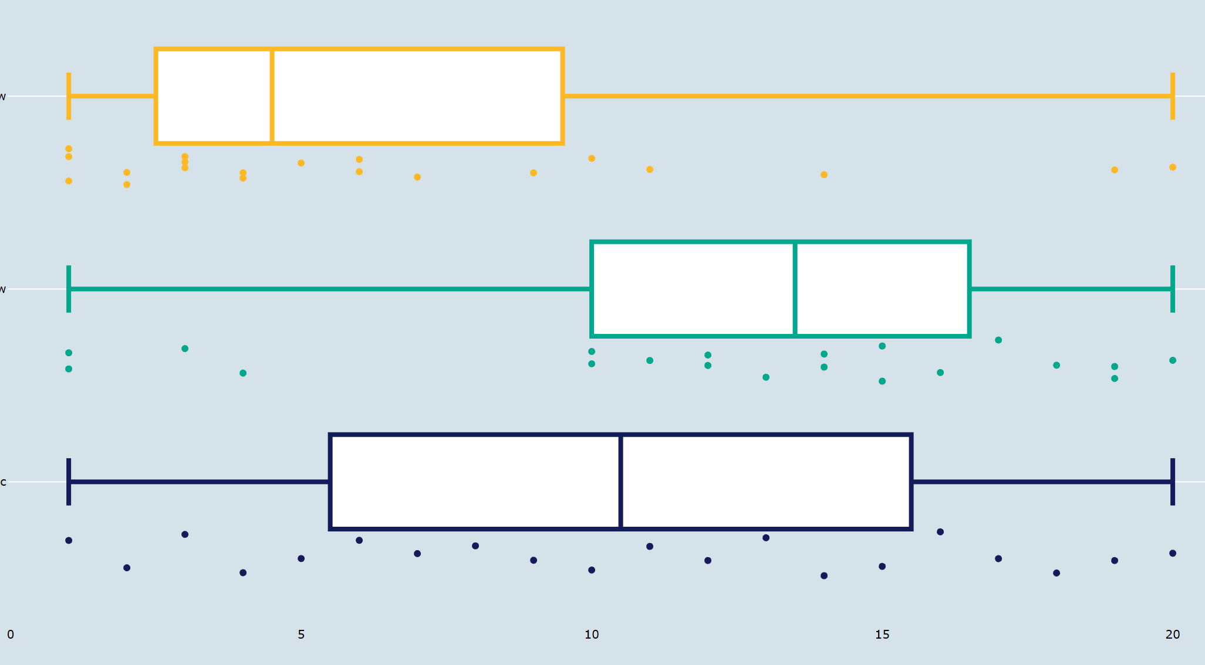
Quick Review
Data Distribution of a Box and Whisker Plot
Positively Skewed
Negatively Skewed
Symmetrical

Slide 6

Philosophical Chairs
Source: https://www.youtube.com/watch?v=19elwVxjfeA

Slide 7
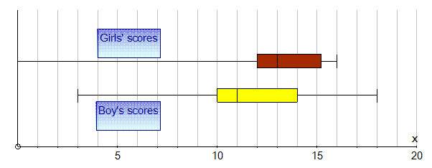
Philosophical Chairs
A teacher was comparing the girls and the boys results on a recent test. By looking at the box and whisker plots, who did better?

Slide 8
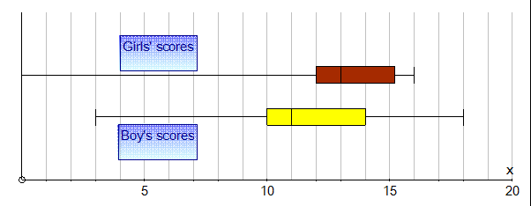
Philosophical Chairs
If you think boys did better, stand at the door side.
If you think the girls did better stand at the window side of the room.
The topic of discussion is who you think did better in the test. Remember, you must use mathematical reasoning or logic to explain your thoughts.

Slide 9
Philosophical Chairs
Boys | Girls
Lowest: 3 Q1: 10 Med: 11 Q3: 14 Highest: 18 | Lowest: 0 Q1: 12 Med: 13 Q3: 15.25 Highest: 16

Slide 10
TASK
MAWA Essentials Unit 1 and 2 text
Chapter 35
Exercise 1- 6

